Slide 1
Morphology and Dynamics of Auroral Arcs
By Sarah Bender
Mentor: Kyle Murphy
8/7/2014

Slide 2
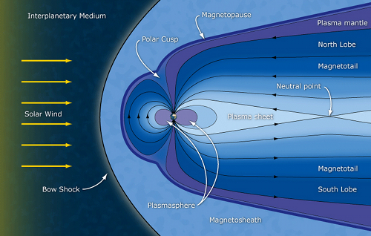
Introduction
Figure 1: The interaction of the solar wind with the Earth’s magnetosphere.

Slide 3
Magnetic Reconnection

Slide 4
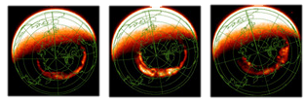
Substorms
An explosive release of energy on the night-side magnetosphere due to the interaction between the coupling of the Sun’s solar wind and the interplanetary magnetic field (IMF) with the Earth’s magnetic field.
The consequential auroral substorm is characterized by a rapid brightening and poleward expansion of the aurora.
The three phases of the auroral substorm: growth phase, expansion phase, and recovery phase.
Notes:
A disturbance of the magnetosphere-ionosphere system in which large amounts of energy from the solar wind that had been stored in the earth’s unstable magnetotail is released.
An explosive release of energy on the night-side magnetosphere due to the interaction between the coupling of the Sun’s solar wind and the interplanetary magnetic field (IMF) with the Earth’s magnetic field.
auroral substorm– rapid brightening and poleward expansion of the aurora.

Slide 5
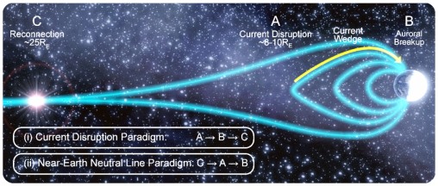
What leads up to substorm onset?
The CD model
The NENL Model
Nishimura et al. model

Slide 6
Nishimura et al. (2010)

Slide 7
Methodology
THEMIS ASI data
27 Substorms, avg. of 3 cameras each
Gaussian fit the poleward, equatorward, and onset arcs.
Map of the ASI ground-based locations.

Slide 8
Data
Keogram image of the GILL, SNKQ, FSMI, and FSIM stations for 2008/03/02 from 4:30:00 to 5:30:00

Slide 9
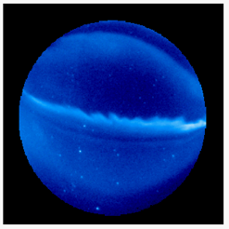
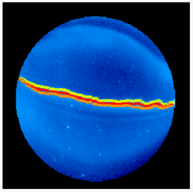
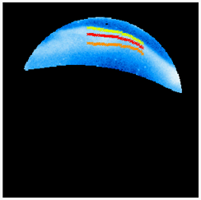
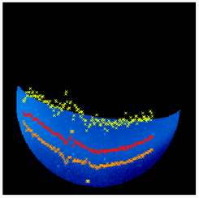
Data
Image from the GILL station on 2008/02/03 from 4:46:00 to 4:56:00.
Full auroral arc, onset arc, poleward arc, and equatorward arcs.
The substorm seen in the GILL camera in relation the rest of the auroral arc.

Slide 10
Conclusions and Future Work
Equatorward motion of the onset arc during the growth phase is typical.
No distinct NS arcs were found.
We will next characterize the intensity and track the brightness of the arcs comparatively as well as the motion within the arc.

Slide 11
References
Kepko, L., et al. (2009), Equatorward moving auroral signatures of a flow burst observed prior to auroral onset, Geophys. Res. Lett., 36, L24104, doi:10.1029/2009GL041476.
Nishimura, Y., et al. (2010), Substorm triggering by new plasma intrusion: THEMIS all-sky imager observations, J. Geophys. Res., 115, A07222, doi:10.1029/2009JA015166.

